Slide 1

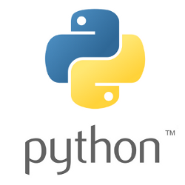

Welcome & Introductions
Framework Training

Slide 2
Introductions
Course Instructor
Introduction
Course attendees
You…
Name
Professional Position
Python / Programming experience
Motivation and Expectations

Slide 3
Course Content
Course objectives
Learn core aspects of Programming
Learn core aspects of Python
What Python is and the Python environment
Python Syntax
Variables and Values
Working with Strings
Flow of control
Python Functions
Data Containers
Files and CSV Files

Slide 4
Questions?
?

